Slide 1

BELMAND COLLEGE NETWORK
PRESENTATION

Slide 2
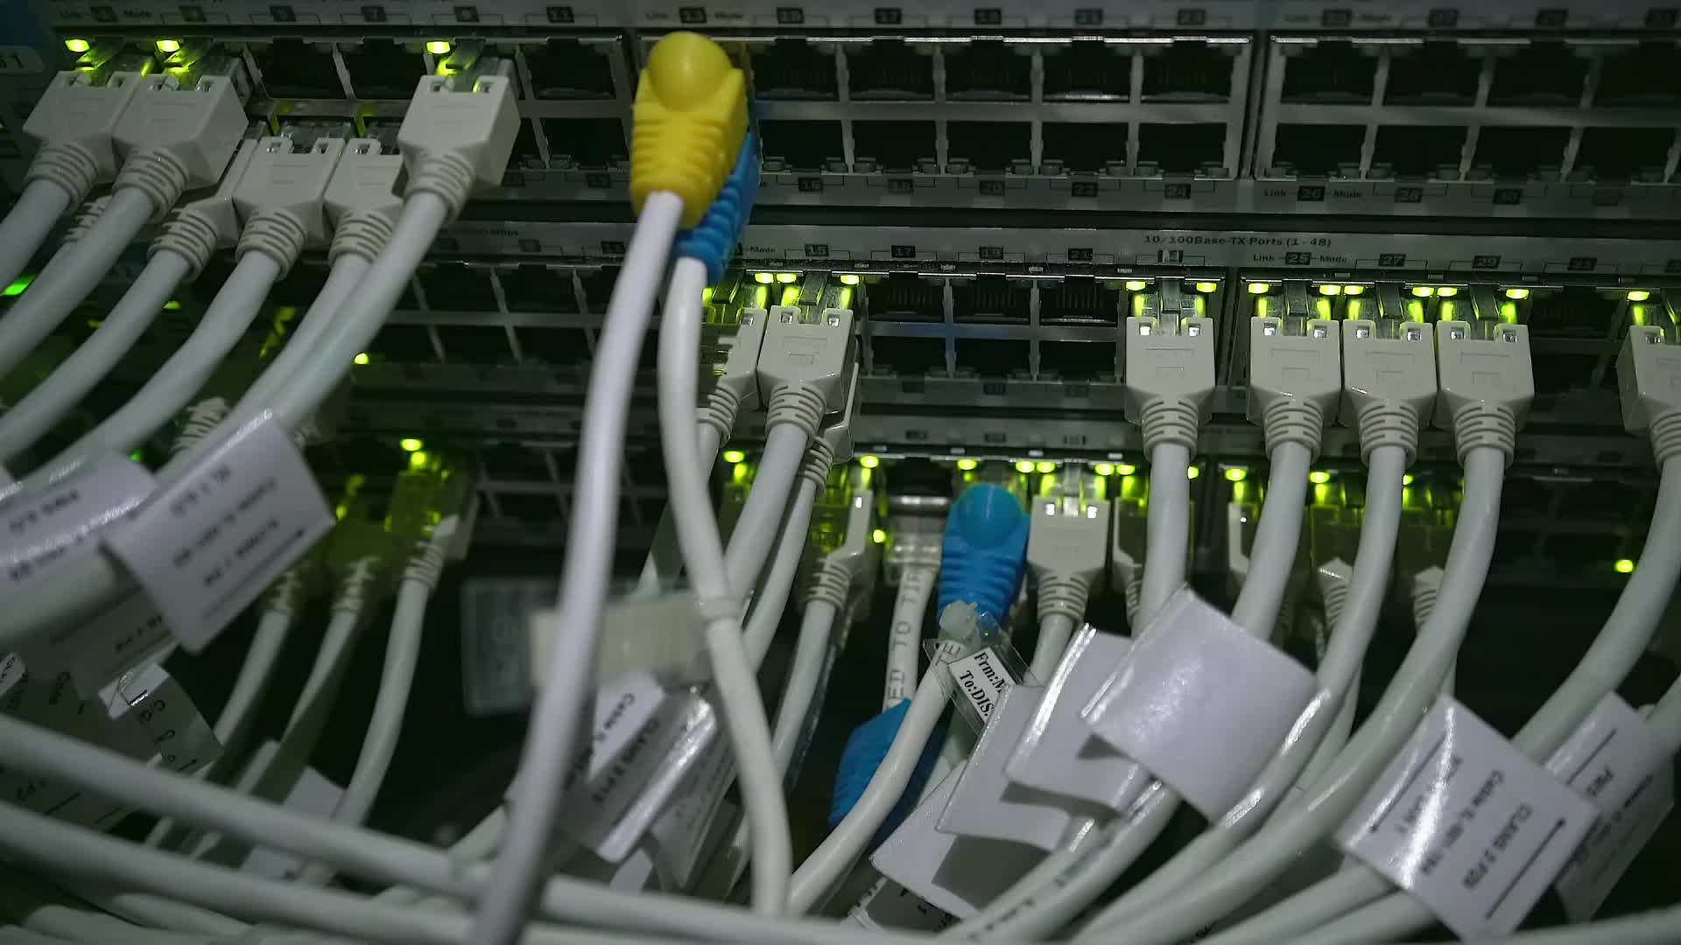
Network Requirements

Slide 3

Introducing Security
Firewalls – this is standard security measure to establish a barrier to enforce strict protocol that prevents intrusions and unauthorized behavior from causing destruction and damage to the network
IPS/IDS – this use of this mechanism will be in place with the firewall and will serve in detection and prevention and detect any malicious intent.

Slide 4

Security
VPNS – With the use of the encryption and tunneling of this communication/network implementation, data traversing the network will be known and received from one source and to one destination and will protect against interceptions.
EMAIL SECURITY – The network communications to students and staff can contain material that is valuable to personnel this will require that highly restrictive measures are incorporated including messaging protocols, and monitoring and controlling practises.

Slide 5

SECURITY
Antivirus/anti-malware software is necessary in this design because unanticipated malware can exploit the host and create back doors if the network is not handled in a secure and thorough manner. The implementation of this software will enhance smooth running programmes and effectiveness overall compatibility.
To further incorporate substantial use of devices Network Access Control is the next barrier to include within the network’s security being that it will ensure that non-complaint devices do not receive accessibility to the network and are places in a quarantine state still they fully complaint with policies to the network/organisation.

Slide 6
Security
SIEM – is a collaboration of Security Information Management and Event Management it portrays a role that support the protection of forms of threats that can be detected when an organizations data is analysed and found that there is activities that are out of the norm then this technology applies appropriate action to reinstate optimum compatibilty.
Website Security – the availability of this property will produce reliability in assuring that there is no infiltration in the system consisting of other measures that include url filtering and application control.

Slide 7

Security
Application security – this is security that takes place at the application and because numerous applications connect to the cloud and other external interfaces, they are susceptible to malware and vulnerabilities therefore, to counter these threat there is need to encryption, authenticate, logging, validity checks, and access control.

Slide 8

Devices
Routers
Switches
Printers
Wireless Access Points
Computers
Servers

Slide 9
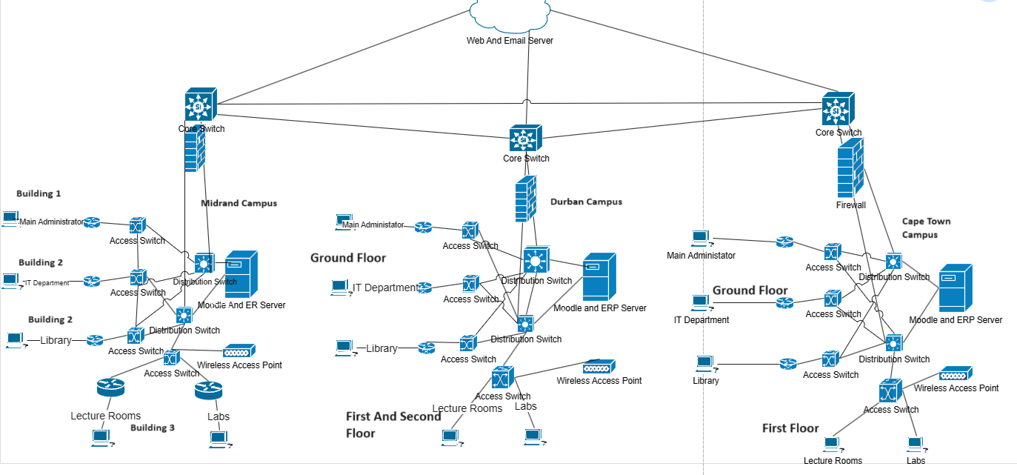
Network Desing Diagram

Slide 10
Network Scheme
Campus | Subnet Allocation | Subnet Mask | Subnet ID | Network ID | IP Adress Range | Building Addresses | Broadcast Address
Midrand | Students | 255.255.255.0 | 255.255.248.0 (/21) | 192.168.8.0(/21) | 192.168.8.1 – 192.168.11.254 | Building B– 192.168.8.1 – 192.168.8.150 Building C- 192.168.9.150 – 192.168.9.254 LABa Building A(Library) – 192.168.8.151 – 192.168.8.201 | 192.168.11.255
 | Staff | 255.255.255.0 | 255.255.254.0 (/23) | 192.168.0.0(/23) | 192.168.0.1 - 192.168.0.74 | Building A(Admin) – 192.168.0.1 – 192.168.0.15 IT Department – 192.168.0.16 – 192.168.0.30 Other – 192.168.0.31 – 192.168.0.74 | 192.168.0.255
Cape Town | Student | 255.255.255.0 | 255.255.248.0(/21) | 192.168.8.0(/21) | 192.168.12.0 – 192.168.13.254 . | Floor 1 – 192.168.12.0 – 192.168.12.100 Ground(Library) – 192.168.12.101 – 192.168.12.175 | 192.168.13.255
 | Staff | 255.255.255.0 | 255.255.254.0 (/23) | 192.168.0.0(/23) | 192.168.0.75 - 192.168.0.149 | Ground(Admin) – 192.168.0.75 -192.168.0.89 IT department – 192.168.0.90 – 192.168.0.103 Other 192.168.0.140 – 192.168.0.149 | 192.168.0.255
Durban | Student | 255.255.255.0 | 255.255.248.0 (/21) | 192.168.8.0(/21) | 192.168.14.0 – 192.168.15.254 | Floor 1 – 192.168.14.0 -192.168.14.120 Floor 2 – 192.168.14.121 – 192.168.14.241 Ground Floor(Library) – 192.168.15.0 -192.168.15.75 | 192.168.15.255
 | Staff | 255.255.255.0 | 255.255.254.0(/23) | 192.168.0.0(/23) | 192.168.0.151 - 192.168.0.254 | Ground Floor(Admin) – 192.168.0.150 – 192.168.0.164 IT Department – 192.168.0.165 – 192.168.0.175 Other – 192.168.0.176 – 192.168.0.254 | 192.168.0.255

Slide 11



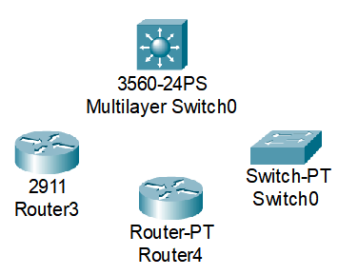

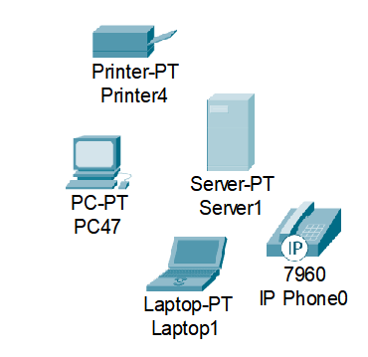
ROLE OF DEVICES
Routers
Switches
Cabling
End-user decives
Servers
Wireless Access Points

Slide 12
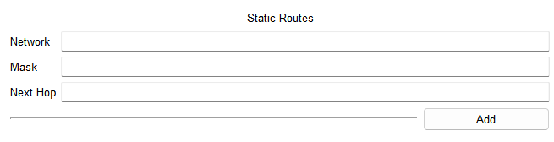
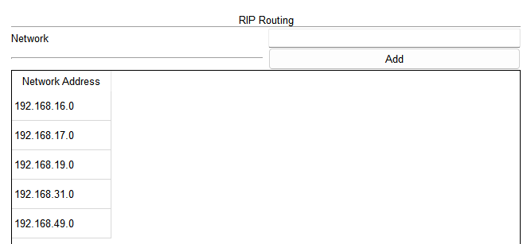

Configuration of Devices and Connections
Router protocols: RIP: uses hop count as its metic
Static: manually configure
Communication between different networks:
Uses routing tables: stores network connection information
Static and Dynamic routing
static: manually done, specifies destination network and next-hop ip address

Slide 13
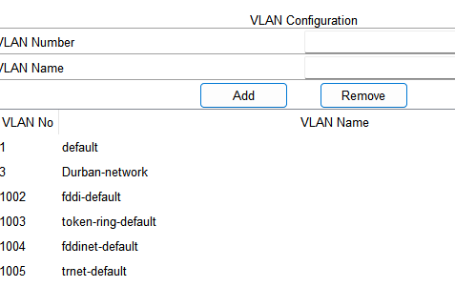
VLAN AND CONNECTIVITY
VLAN and benefits:
network performance
simplified network management
VLAN configurations to segment network
VLAN tagging and trunking:
Tagging: allow switch to identify which VLAN a packet belongs to
Trunking: transmitting traffic for multiple VLANS between switches

Slide 14
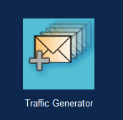

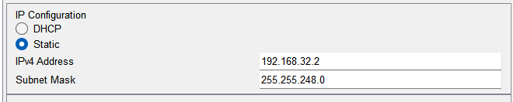
END DEVICES AND SERVERS
Importance: Endpoints communications and responsible for actions on data transmitted.
Application of DHCP and IP Addressing: Setting and usability of IP addresses,

Slide 15
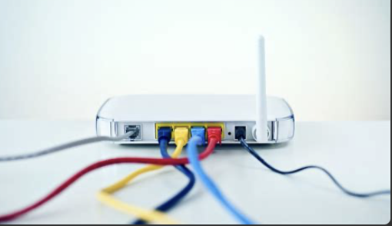
Security and Wireless Access
Remote Work Configuration:
Utilize a VPN device or configure a router with VPN capabilities. Set up a VPN server on the network, often done on a Cisco router by enabling VPN features and defining a VPN pool of IP addresses.
This setup allows remote employees to securely connect to the college's network through encrypted tunnels.
Wireless Access Configuration: Drag a wireless router or a router with a wireless module into your workspace.
Set up the wireless router by configuring the SSID, security mode and a strong password.
Connect this wireless router to the rest of the network using an Ethernet cable.
For Remote Work:
By implementing these configurations in Cisco Packet Tracer, you can simulate a network that supports secure remote work through VPN access, while also providing secure wireless connectivity for on-site users.

